Slide 1

HACKATHON
SMART VEHICLE
Propose a smart vehicle system using advanced sensors and navigation

Slide 2

Team members
ALFI JAMES (BAI026)
NITHYAA SRI (BAI015)
SWATHI (BAI016)

Slide 3

ABSTRACT
This project aims to develop a smart vehicle system focusing on two-wheeler, importing digital map and real-time traffic prediction.
The system will utilize GOOGLE MAP techniques for accurate traffic prediction.
In this system there will be a digital screen map, with voice assistance, enhances the user experience, and hands-free navigation system for two-wheeler riders.
This comprehensive solution aims to offer the quickest and most efficient routes while ensuring user convenience and safety.

Slide 4


PROBLEM STATEMENT
Lack of time due to traffic and accident in there route.
Depending on a pillion that is the person who sits in the back seat.
Depending on phone map which causes lack of time while checking the route.

Slide 5
EXISTING WORK
Connected through
Bluetooth
>>Navigation assist
>>Last parked location
>>Voice assist
>>Tripper
>>Clock display
>>Low battery indication
TVS NTORQ 125
TVS Jupiter
Suzuki Access 125
ROYAL ENFIELD Hunter 350
and many more

Slide 6

NEW FEATURES
Displaying
Digital map
Clock with date and time
Digital speed meter
Voice Recognition
GPS
Water resistance
Day and Night mode
Making the short route in case of traffic and accident in the route this helps mainly for delivery
Storing personal location like home and work

Slide 7
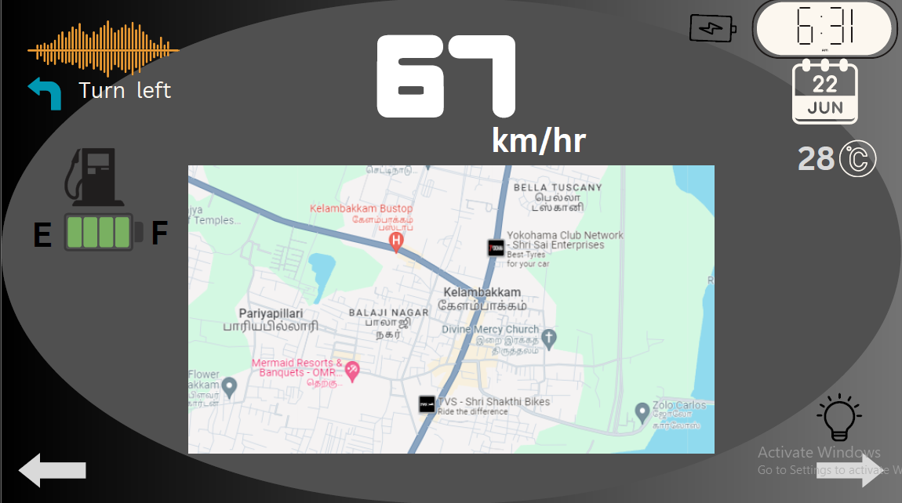
PROTOTYPE
Phone battery
Time
Voice assist
Direction navigator
Date
Speed Meter
Temperature
Fuel tank
Map
Head light
Left Indicator
Right Indicator

Slide 8
CONCLUSION
We guess this project will help us to save the time while driving. Car companies like Tata, Mahindra, Hyundai, Toyota ,etc.. are also using this navigation system.

Slide 9
Thank you!

